Slide 1
General Introductory Pharmacology Pharmacokinetics-Basic concepts
Arnold Forkuo Donkor, PhD
College of Health Sciences,
Faculty of Pharmacy & Pharm. Sciences,
Department of Pharmacology, Rm C115

Slide 2
References
Rang & Dale
Katzung, Basic and Clinical Pharmacology
For those who want to know more: Goodman and Gilman’s “The Pharmacological Basis of Therapeutics”
www…
Nothing in life is to be feared, it is only to be understood.
Marie Curie

Slide 3
OBJECTIVES:
After attending lectures and studying this course you should be able to
Define pharmacology and associated terms.
Know the difference between the Generic Name of a drug and its Trade Name.
Know the processes by which a drug travels from the point of delivery to its site of action and out of the body-ADME Processes

Slide 4
PHARMACOLOGY:
Defined as the study of the interaction of substances (drugs), other than foods, with living systems.
the study of drugs and their actions on biological systems.
Notes:
Illness has been man’s heritage from the beginning of his existence, and the search for remedies to combat it is perhaps equally old.
Pharmacology studies the effects of drugs and how they exert their effects. For example, penicillin cures certain bacterial infections and acetylsalicylic acid (ASA) can reduce inflammation. How do they accomplish these respective effects? Through research we now know that penicillin can disrupt the synthesis of cell walls in susceptible
bacterial strains by inhibiting a key enzyme, while ASA can inhibit the action of a human cell membrane enzyme known as cyclooxygenase, which is responsible for the synthesis of a number of inflammatory mediators.
Pharmacology should be distinguished from the profession of pharmacy, whose responsibilities include the identification, verification, standardization,
compounding, and dispensing of drugs and dosage forms of drugs

Slide 5
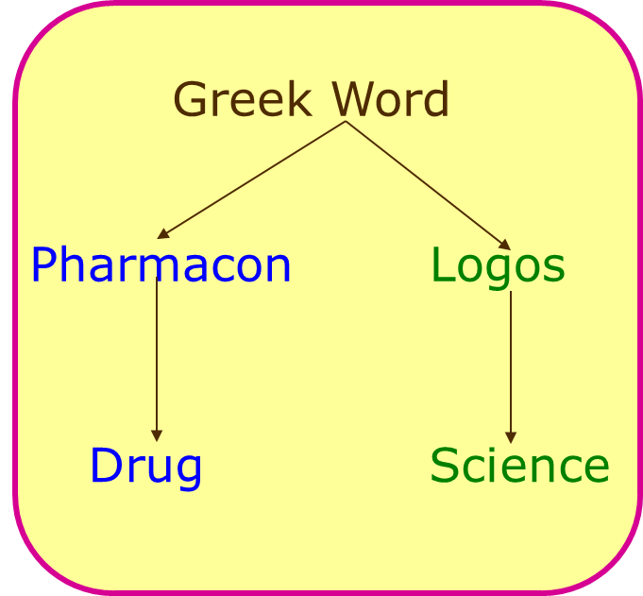
Terminologies
Pharmakon- Drug or Poison
Drug: Any substance or product, used to alter the body's physiological function or pathological states for the benefit of the recipient.
Used to cure/treat (therapeutic)
Prevent (Prophylaxis) or
Diagnosis diseases in man or animals.
Notes:
It attempts to describe the biological responses produced by drugs and to define the underlying mechanisms by which the responses are generated.
Define the following allied aspects of Pharmacology – Pharmacognosy, pharmacoepidemiology, pharmacoeconomics, pharmacovigilance, pharmacogenetics, pharmacogenomics, toxicology, chemotherapy.

Slide 6
NATURE AND SOURCES OF DRUGS
Mineral
Animal
Plant
Synthetic
Micro-organisms
Drugs produced by genetic engineering
Liquid paraffin, magnesium sulfate, etc
Insulin, Thyroid, etc.
Morphine, Quinine etc
Aspirin, Sulfonamides, etc.
Penicillin & other antibiotics.
Human insulin, human growth, hormone etc.
Notes:
.

Slide 7
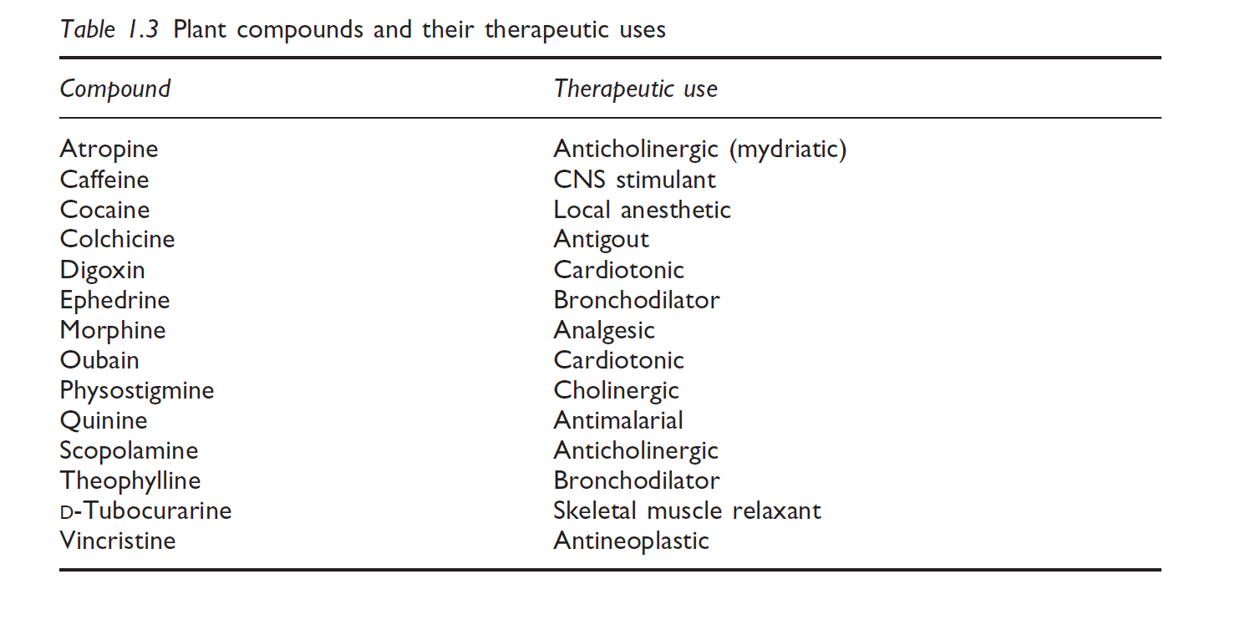
NATURE AND SOURCES OF DRUGS

Slide 8
MICROORGANISMS AS A SOURCE OF DRUGS
Microorganisms have, of course, been extensively screened for antibiotics since Alexander Fleming’s discovery of the antibacterial activity of Penicillin notatum in the 1920s.
Numerous useful antibiotics are also produced by bacteria of the Streptomyces genus (including streptomycin, neomycin, tetracycline, and chloramphenicol) as well as by fungi (griseofulvin and cyclosporin C)
Notes:
Other sources include Marine sources ( Docosahexaenoic acid (DHA), developed via fermentation of a microalgae – Major component in the human brain), Animal sources; 1. maggot debridement therapy where maggots are used to treat open wound (Maggot therapy)- Feeds on necrotic tissues whiles leaving healthy tissues.
2. A natural anticoagulant, hirudin derived from the saliva of the leech.
3. Snake venoms have been found to possess ingredients with important pharmacological properties. Eg Captopril (ACEI) was originally identified in the venom of the pit viper as a bradykinin-potentiating peptides (BPPs) – Captopril is a dipeptide analog BPP.

Slide 9
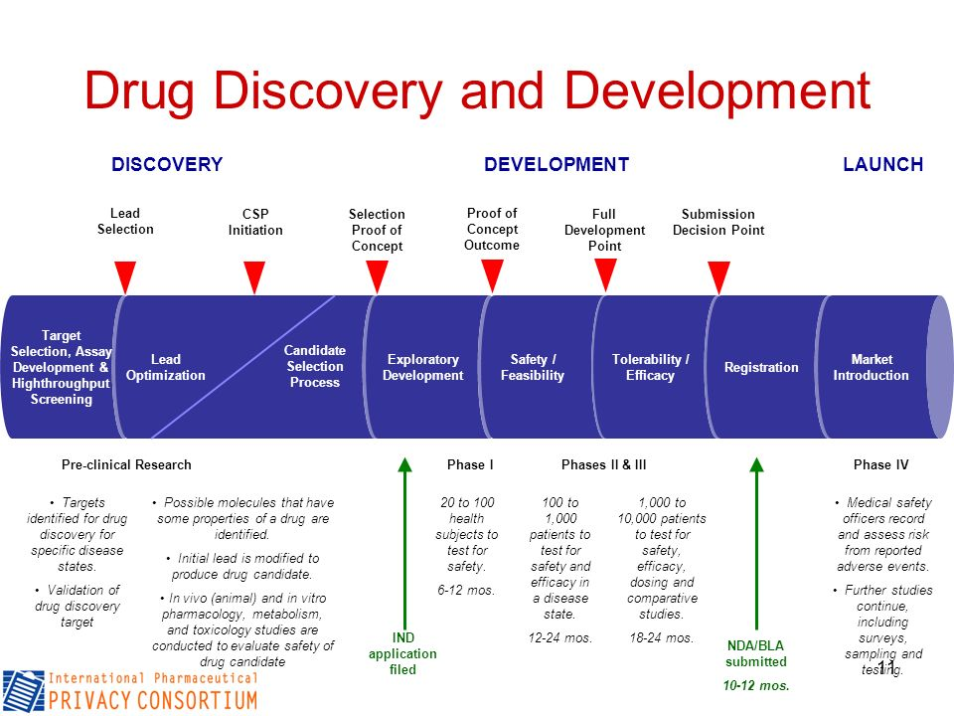

Slide 10
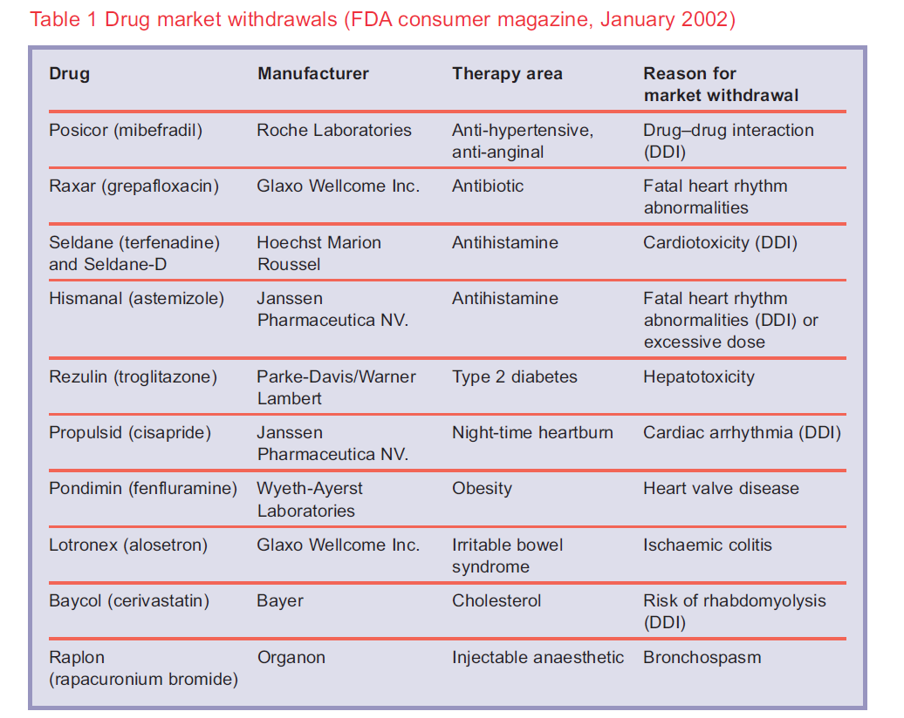

Slide 11
Pharmacology Terminologies
Indications
Conditions that enable the appropriate administration of the drug (as approved by the FDA).
Contraindications
Conditions that make it inappropriate to give the drug
…..means a predictable harmful event will occur if the drug is given in this situation
Dosage
The amount of the drug that should be given

Slide 12
Pharmacology Terminologies
Routes of Administration
How the drug is given.
Side Effects/Adverse Reactions
The drug’s untoward or undesired effect
Mechanism of Action
The way in which a drug causes its effects; its pharmacodynamics

Slide 13

Pharmacology Terminologies
Medical pharmacology is studying processes by which:
a drug travels from the point of delivery to its site of action and out of the body- Pharmacokinetics
drugs alter body functions-
Pharmacodynamics
Pharmacology deals with the fate and actions of drugs in the body

Slide 14
Pharmacology
is an integrative discipline involving fields of study such:
organic chemistry
biochemistry
physiology
pathology and
microbiology.

Slide 15
Pharmacology: Subdivisions of particular importance include:
Pharmacokinetics:
a drug travels from the point of delivery to its site of action and out of the body
Pharmacodynamics
drugs alter body functions-
Pharmacotherapeutics (Therapeutics):
The application of pharmacology to the problems of clinical medicine.
Chemotherapy:
The use of drugs, which ideally have little effect on the host (patient) but destroy or retard the growth of invading cells and organisms.

Slide 16
Pharmacology: Subdivisions of particular importance include:
Toxicology:
The pharmacology of poisons and the harmful effects of any drug.
Pharmacoeconomics:
is the study of the cost-effectiveness of drug treatments; the cost of medications is of worldwide concern, particularly among certain groups such as the elderly and AIDS patients.
Pharmacoepidemiology:
is the study of the effect of drugs on populations; questions dealing with the influence of genetics are particularly important

Slide 17
Assignment 1
Briefly describe the role of the following scientists in the development of Pharmacology as a Science.
Friedrich Worler
Francois Magendie
Claude Bernard
Oswald Schmiedeberg
William Withering
John Jacob Abel

Slide 18
DRUG NOMENCLATURE

Slide 19
Drug Names
Throughout the process of development, drugs may
have several names assigned to them: a chemical name, a generic (nonproprietary) name, an official name, and a trade or brand name.
Chemical name:
A systematized and standardized nomenclature that encodes within the name descriptive information about the molecular constitution of the drug (e.g., 2-acetoxybenzoic acid) or simply any typical organic chemical name.

Slide 20
Generic name:
The assigned name of a drug, by which it will be known throughout the world no matter how many different companies manufacture it. This name is usually assigned and agreed upon by the WHO, USAN or USP Committees (e.g., Aspirin).
Official name:
This is the name by which a drug is listed in one of the following official publications: a) U.S. Pharmacopoeia, b) National Formulary
The official name is often the same as the generic name. (e.g., acetylsalicylic acid)

Slide 21
Trade name:
The name that is given by a particular company that is manufacturing the drug.
This name is the property of the registrant.
Sometimes a single generic drug may be sold under 5 or 10 different trade names.
(e.g., EmpirinTM).

Slide 22
Names of Drugs
Chemical Name | 7-chloro-1, 3-dihydro-1, methyl-5-phenyl-2h-1
Generic Name | Diazepam
Official Name | Diazepam, USP
Brand Name | Valium®

Slide 23
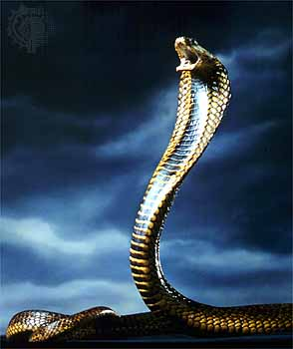
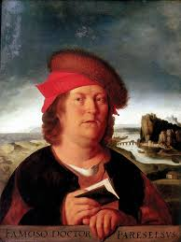
All substances are poisons; there is none that is not a poison. The right dose differentiates a poison from a remedy.
Paracelsus, 1493-1541
Notes:
He also said ‘What else is the help of medicine than love?”

Slide 24
PHARMACODYNAMICS DRUGS ALTER BODY FUNCTION

Slide 25
PHARMACODYNAMICS
Types of drug- receptor interactions
Agonist
Antagonist
Partial Agonist
Duration of drug action
mainly determined by the type of bond between drug and receptor
Receptors And Inert Binding Sites
Other colleagues with go into details with the Pharmacodynamic aspects of Pharmacology.

Slide 26
PHARMACOKINETICS FATE OF DRUGS IN THE BODY

Slide 27
INTRODUCTION
Pharmacokinetics is the study of the processes by which a drug travels from the point of delivery to its site of action and out of the body.
Branch of pharmacology that studies the fate of a drug in the body i.e ‘what the body does to a drug’.

Slide 28
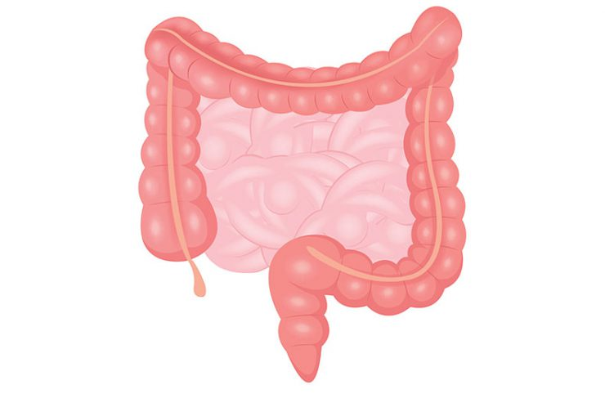
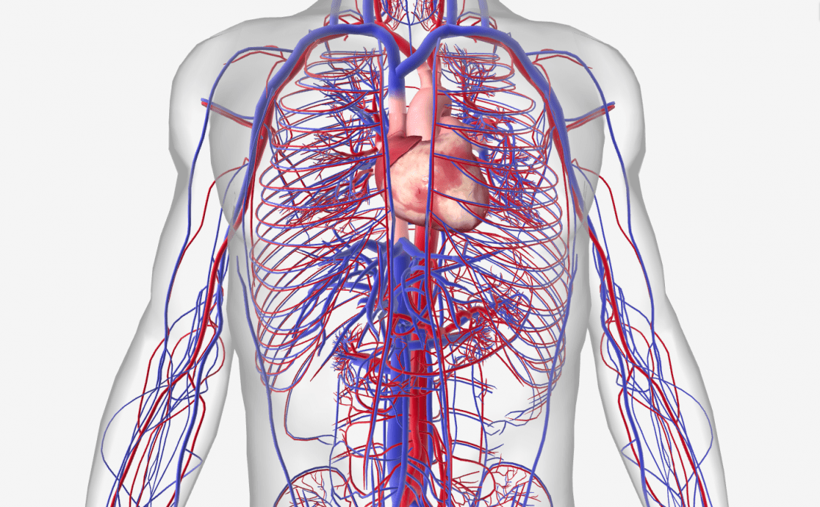
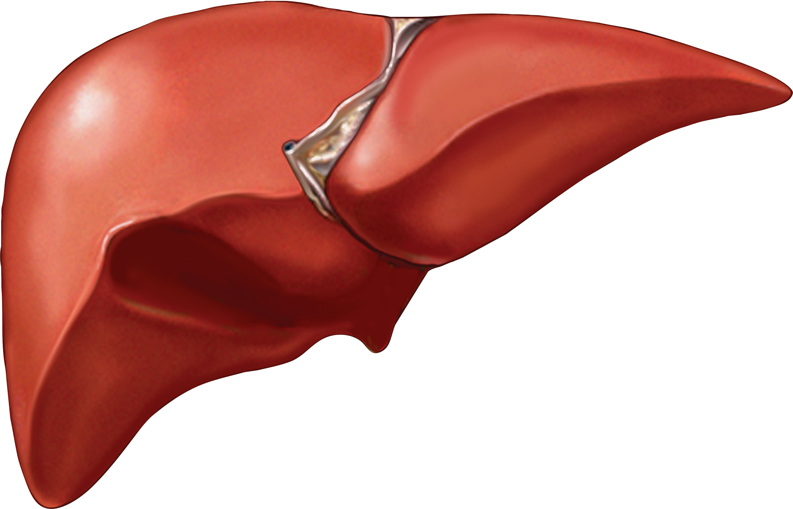
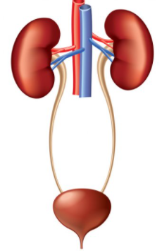
4 Arms of pharmacokinetics (ADME)
ABSORPTION
DISTRIBUTION
METABOLISM
EXCRETION
How will it get in?
Where will it go?
How is broken down?
How does it leave?

Slide 29
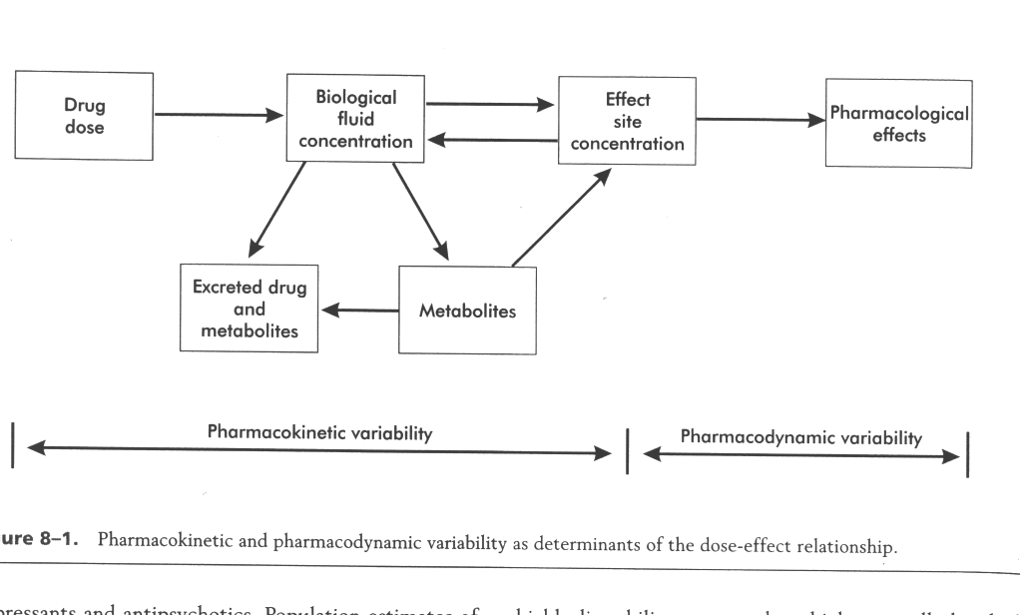
Overview

Slide 30
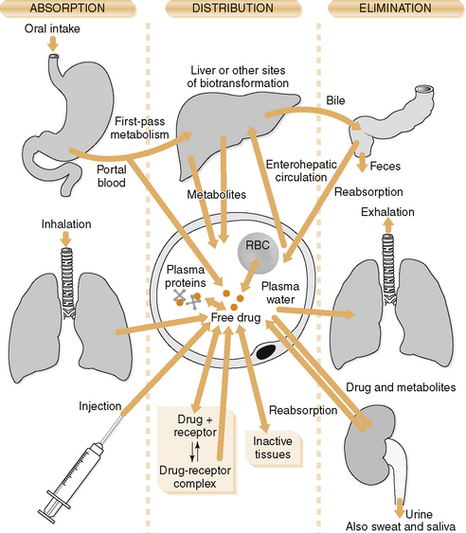

Slide 31
PHARMACOKINETICS- BASIC CONCEPTS
The therapeutic effect of a drug is determined by the concentration of drug at the receptor site of action.
Even though the concentration of drug that reaches the target receptor is dependent upon the dose of the drug, there are other factors that influence the delivery of the drug to the target site.
These include absorption, distribution, metabolism, and (elimination) excretion.
The study of these variables is called pharmacokinetics.

Slide 32
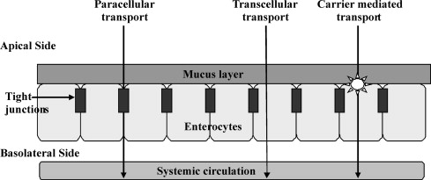
Movement of drug molecules across cellular barriers

Slide 33
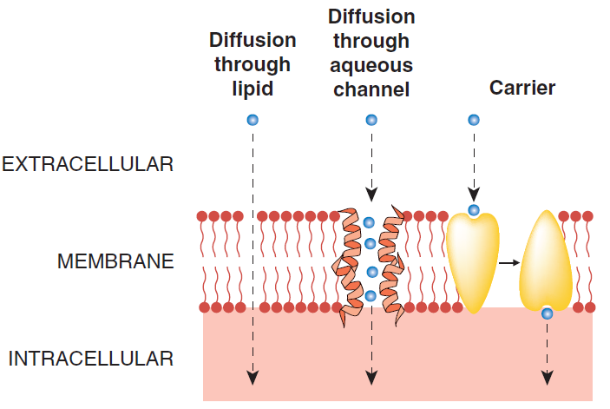
Movement of drug molecules across cellular barriers

Slide 34
II. PHARMACOKINETIC PROCESSES (ADME) Absorption Distribution Metabolism and Excretion The Life Cycle of a Drug (pharmacokinetics)
Elimination

Slide 35
Introduction
Most drugs :
enter the body (by mouth or injection or…) - must cross barriers to entry (skin, gut wall, alveolar membrane…..)
are distributed by the blood to the site of action - intra- or extra- cellular - cross barriers to distribution (capillaries, cell wall….)
- distribution affects concentration at site of action and sites of excretion and biotransformation

Slide 36
Introduction
are biotransformed perhaps to several different compounds by enzymes evolved to cope with natural materials - this may increase, decrease or change drug actions
are excreted (by kidney or …….) which removes them and/or their metabolites from the body
Pharmacokinetics is the quantification of these processes

Slide 37
Absorption, Distribution, Metabolism & Excretion (ADME)
Learning Objectives
know the main processes determining the ADME drugs in the body;
be able to exemplify how these processes can be affected by disease, diet, drugs and other factors;
know how alterations in these processes can affect the outcome of drug treatment.
Appreciate how differences in these processes between patients can affect therapy
Know how these processes have been exploited to improve therapy
List the various routes of drug administration with advantages and disadvantages of each.

Slide 38
ABSORPTION
ADME

Slide 39
Absorption
Generally defined as the passage of drug from the site of administration into the plasma or the systemic circulation
Depends on
patient compliance
rate and extent of transfer from the site of administration to the blood
Rate and efficiency of absorption depends on a drug´s route of administration

Slide 40
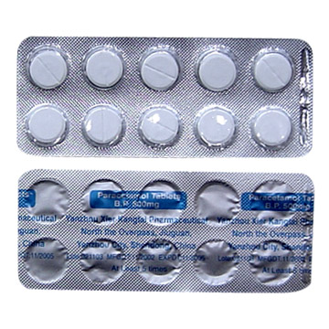
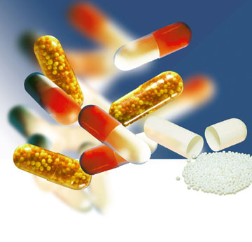
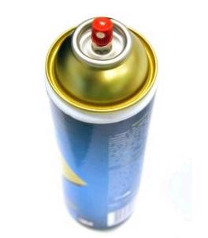
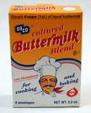
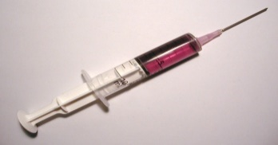
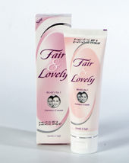
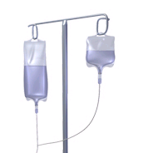
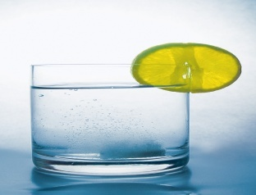
DRUG DOSAGE FORMS
Tablets
Aerosol
Capsule
Suspension
Injection
Cream
Infusion
Solution

Slide 41
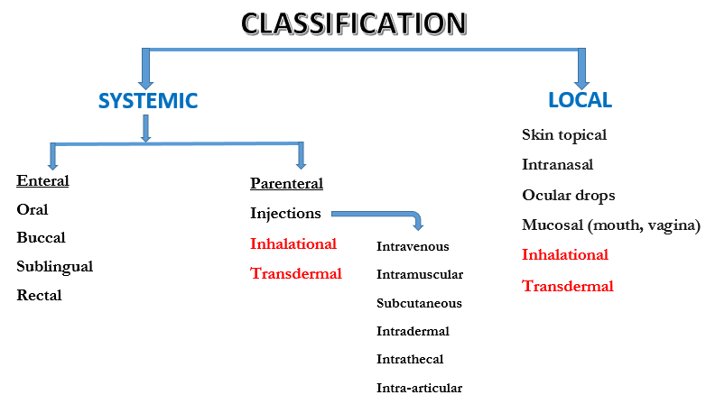
ROUTE OF ADMNISTRATION

Slide 42
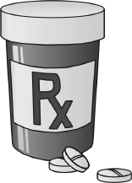
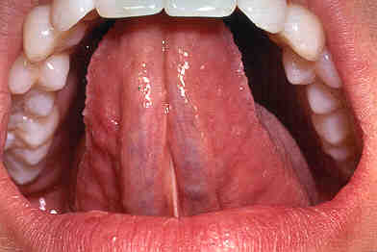
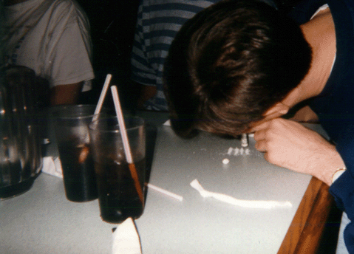
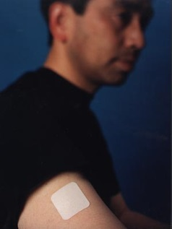
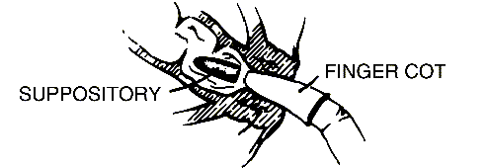
Slow Absorption
Orally (swallowed)
through Mucus Membranes
Oral Mucosa (e.g. sublingual)
Nasal Mucosa (e.g. insufflated)
Topical/Transdermal (through skin)
Rectally (suppository)

Slide 43
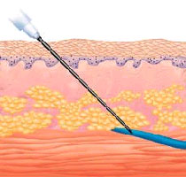
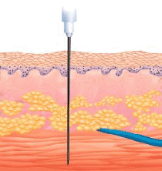
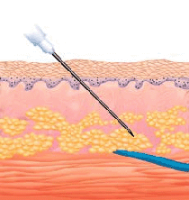
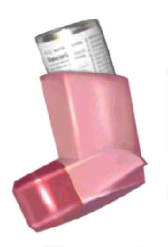
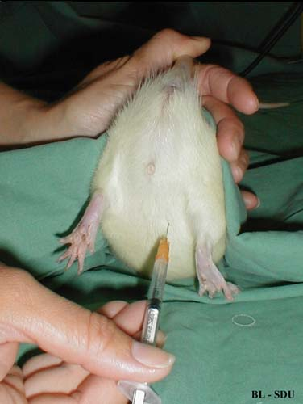
Faster Absorption
Parenterally (injection)
Intravenous (IV)
Intramuscular (IM)
Subcutaneous (SC)
Intraperitoneal (IP)
Inhaled (through lungs)

Slide 44
Fastest Absorption
Directly into brain
Intracerebral (into brain tissue)
Intracerebroventricular (into brain ventricles)
General Principle: The faster the absorption, the quicker the
onset, the higher the addictiveness, but the shorter the duration

Slide 45
Absorption: Solubility
Water-soluble
Ionized (have electrical charge)
Crosses through pores in capillaries, but not cell membranes
Lipid(fat)-soluble
Non-ionized (no electrical charge)
Crosses pores, cell membranes, blood-brain-barrier
Dissociation constant or pKa → indicates the pH where 50% of the drug is ionized (water soluble) and 50% non-ionized (lipid soluble);
pKeq = pH + log [X]ionized/[X]non-ionized
This affects a drug's solubility, permeability, binding, and other characteristics.

Slide 46
Drug Absorption :Routes of Administration
The main routes of administration for drugs can be categorized into four groups:
1. Enteral route
oral ingestion, sub-lingual and rectal (into the GIT)
2. Parenteral route (by inj.)
Intravenous (i.v.), intraarterial (i,a.), subcutaneous (s.c.), intramuscular (i.m.), intraperitoneal (i.p.) and intrathecal
3. Topical route (i.e. application to epithelial surfaces or mucous membranes) → skin, cornea (eye), vagina and nasal mucosa etc.),-usually local effects
4. Inhalational (lungs)-
usually local or systemic effects

Slide 47
Drug Absorption :Routes of Administration
Other classification:
Oral:
Drugs administered by mouth and swallowed.
Transcutaneous:
Used when local effects on the skin is required e.g. Topical creams, transdermal patches for nicotine withdrawal symptoms, fentanyl for analgesia & GTNT for angina.
Transmucosal e.g. Sublingual,
absorption directly from the oral cavity [drug must have good taste], rectal (supp.) conj, vaginal (pess),nasal adm,
Inhalational
Drugs administered this way to achieve much higher concentrations in the lungs than elsewhere in the body.e.g Inhalers, Inhalational anaesthethics etc.
Parenteral (by inj.)

Slide 48
Drug Absorption :Routes of Administration
Depends on route of administration
Oral (per os)
A. Site of absorption
1. Oral mucosa – sublingual route
Direct access to systemic veins - will avoid hepatic first pass effect (direct absorption into systemic venous circulation)
(Drugs that are extensively metabolized.)
Ex: nitroglycerin
2. Stomach
Drugs that are weak acids tend to be absorbed here. Ex: aspirin, ethanol
3. Small intestine
Drugs that are weak bases tend to be absorbed here

Slide 49
Drug Absorption :Routes of Administration
B. Advantages of oral route
Most convenient
Least unpleasant method for most drugs
No equipment required
Safest (drug absorbed more slowly)

Slide 50
Drug Absorption :Routes of Administration
C. Disadvantages of oral route
1. Certain drugs destroyed by pH and/or enzymes
Ex: Insulin
Some drugs metabolized in gut wall by Cyp3A4
Bacterial metabolism in gut can affect bioavailability
Ex: so digoxin is only 70% bioavailable
2. Slow onset of action
3. Cannot give to unconscious patient
4. Irritating substances cause nausea and vomiting, resulting in drug loss
5. Drug may have significant 1st pass effect from stomach or intestine because of direct access to portal veins
6. Liver can excrete drug into the bile

Slide 51
Drug Absorption :Routes of Administration
7. Irregular absorption may occur due to:
a) Variation in process of solution
b) pH variation
If drug is too hydrophilic (i.e. atenolol), the drug cannot cross the lipid cell membrane; if too lipophilic (i.e. acyclovir), the drug is not soluble enough to cross the water layer adjacent to the cell
c). Binding to food (e.g. tetracycline chelated to Ca⁺⁺ and other heavy metals)
d). Variation in motility and emptying time of GI
e). Reverse transporter associated with P-glycoprotein process actively pumps drug out of gut wall cells back into the gut lumen
Tx: grapefruit juice – will inhibit P-glycoprotein and gut wall metabolism

Slide 52
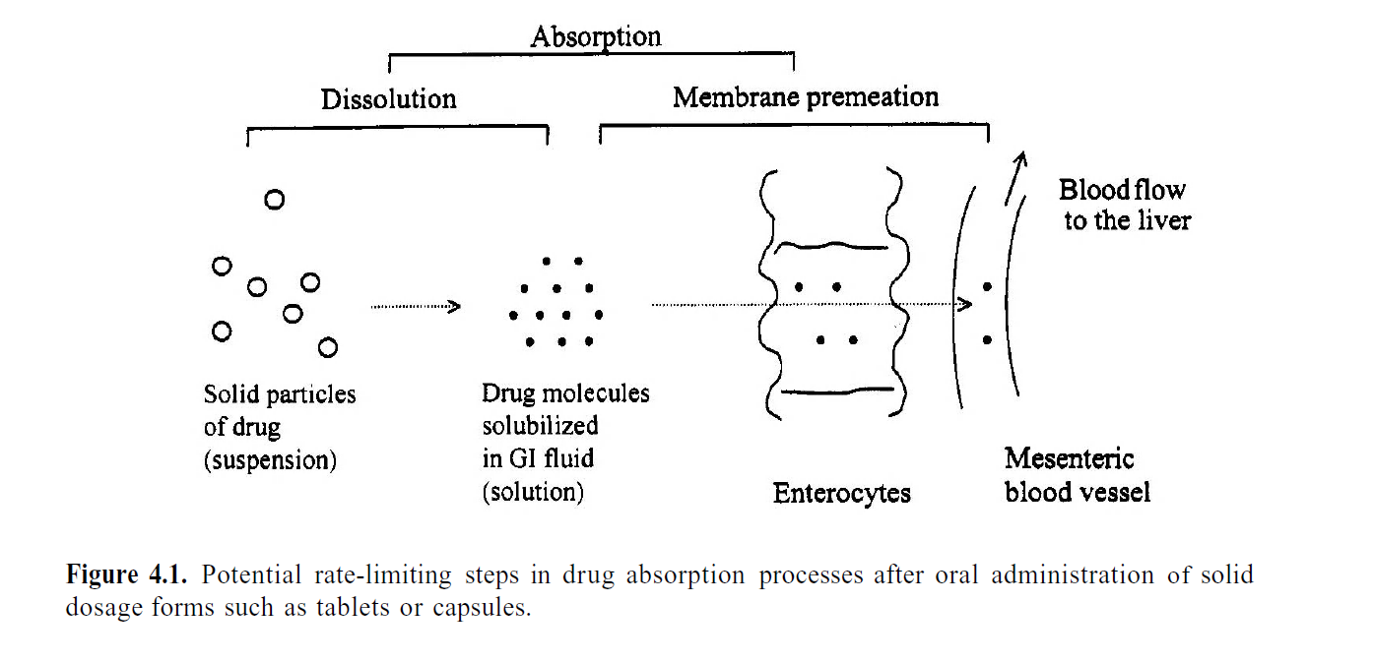

Slide 53
Oral absorption
Drug absorption after oral administration has two (2) components:
The Rate of Absorption
Bioavailability of the drug.

Slide 54
Oral absorption
THE RATE OF ABSORPTION
The rate of absorption is partially controlled by the physicochemical characteristics of the drug.
This could be modified by formulation to enhance or slow the rate of absorption.
Reduction in the rate of absorption can lead to a smoother concentration-time profile with a lower potential for concentration-dependent adverse effects. [may even allow less frequent dosing]

Slide 55
Oral absorption
BIOAVAILABILITY
Is the term used to describe the fraction of the administered dose (free unchanged form) that is absorbed into the systemic circulation.
( Differ from bioequivalence ▬drug products are bioequivalent when the rate and extent of bioavailability of the active ingredients do not differ significantly)
Bioavailability ranges from 0 to1 or 0 to 100 %.
i.v injection gives 100% bioavailability
Calculated from comparison of the area under the curve (AUC) relating plasma concentration to time for i.v. dosage compared with other route.
Says nothing about effectiveness.

Slide 56
Oral absorption
Absorption occurs via passive diffusion and is governed by blood flow, surface area, drug concentration & formulation.
Theoretically drugs that are weak acids would be optimally absorbed from the acid environment of the stomach.
And drugs that are weak bases from the alkaline environment of the intestine.
The small surface area of the stomach and its thick mucosa limits absorption.
In contrast, as a result of the huge surface area of the intestines, the rate of absorption of ALL drugs is greater in the intestines.
Changes in the rate of gastric emptying influence rate of presentation of drug to the intestine, and therefore influence rate of absorption.

Slide 57
Oral absorption
Though the unionized form of a drug is absorbed more rapidly than the ionized form at any particular site in the GI tract,
the OVERALL RATE of absorption of a drug from the intestine > that from the stomach even if the drug is relatively more ionized in the intestine than in the stomach.

Slide 58
Bioavailability
It depends on a number of physico-chemical & clinical factors.
What determines bioavailability?
Physical properties of the drug (hydrophobicity, pKa, solubility)
The drug formulation (immediate release, delayed release, etc.)
If the drug is administered in a fed or fasted state
Gastric emptying rate
Interactions with other drugs
Age
Diet
Gender
Disease state
Notes:
Bioavailability may be altered:
By low lipid solubility of the drug
If drug is destroyed by the acid in the stomach (e.g. X’Pen).
By the presence of food in the G.I.T.
Co-administration with other drugs.
e.g. Heavy metals in antacids can reduce the absorption of quinolones (e.g. Ciprofloxacin) and tetracyclines by binding them in the gut.
For drugs that are susceptible to extensive first pass metabolism, a substantial portion or almost all the drug could be metabolized in the liver before it reaches the site of action. E.g. GTNT, (low oral bioavailability 0 or<0.5)
Drugs with very low lipid solubility such as strong acids: pKa ≤ 3 or strong bases pKa ≥ 10 (e.g.suxamethonium); are fully ionized in the GIT, may not be absorbed when administered orally.
[administer parenterally]
Other highly polar molecules such as amino- glycosides and vancomycin are also poorly absorbed from the G.I. (Very low oral bioavailability).
These drugs are usually formulated as injections.
Drugs such as levodopa and others are exceptions since they are absorbed by carrier mediated mechanisms.

Slide 59
Bioavailability
Destroyed
in gut
Not
absorbed
Destroyed
by gut wall
Destroyed
by liver
Dose
to
systemic
circulation
GEN. INTRO. PHARMACOLOGY
59

Slide 60
Absorption
Parenteral- Term used for ones delivered by injection
- Improved bioavailability but requires skilled personnel
A. Advantages of parenteral route
1. More rapid and predictable absorption
2. Used to administer drugs that would be destroyed by stomach acid or enzymes
3. Use with unconscious or uncooperative patient
4. More accurate dose selection
B. Disadvantages of parenteral route
1. Strict asepsis must be maintained
2. Pain associated with injection
3. Self administration may be difficult
4. More expensive
5. Possibility of technical errors (rate of dosing, area given)
6. Difficult to correct overdose or error
7. Risk of infection or local irritation

Slide 61
Assignment
Read on the following parenteral routes of drug administration, highting the advantatages and disadvantages of each route
intravenous
subcutaneous
intramuscular

Slide 62
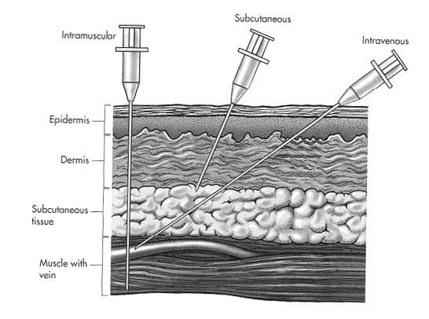
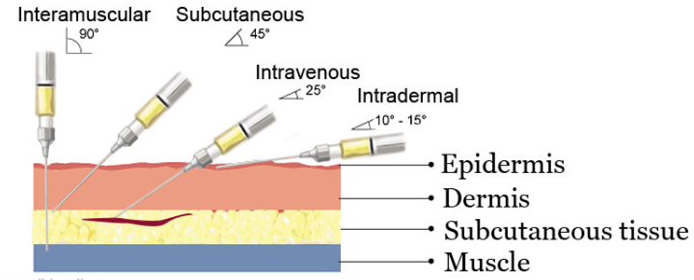
Parenteral route of drug administration

Slide 63
P a r e n t e r a l administration | the onset of action at
i n t r a v e n o u s - instantaneous and complete absorption - more dangereous (vancomycin) | 1-2 min
i n t r a m u s c u l a r - faster and more complete than per os, but in severe hypotension blood flow may be low and i.m. absorption slow, incomplete - for larger size of particles (suspension), lipid soluble ones ( injection of depot preparations results in very slow absorption.) | 10-15 min
s u b c u t a n e o u s | 20 min

Slide 64
OTHER ROUTES
Epidural: between dura matter and brain
Intra-articular: into a joint
Intracerebral: directly into the brain
Intraperitoneal: peritoneal cavity
Intraarterial: into arteries
Intraosseous: into bones
Assignment
Differentiate between Prodrugs (Carrier-linked, Bioprecursor and Codrug) and Antedrugs.
What is the rationale for drug coating? – Enteric, Sugar and Film coating.

Slide 65
Summary: Factors affecting oral absorption
Disintegration of dosage form
Dissolution of particles
Chemical stability of drug
Stability of drug to enzymes
Motility and mixing in GI tract
Presence and type of food
Passage across GI tract wall
Blood flow to GI tract
Gastric emptying time
FORMULATION

Slide 66
DRUG DISTRIBUTION
ADME

Slide 67
DRUG DISTRIBUTION
Once the drug enters the blood stream, it may be distributed into the body fluids (body water).
The extent of distribution depends on:
Regional blood flow.
Drug Binding to plasma proteins (macromolecules in blood or tissues)
Partition co-efficient into fatty tissues (lipid solubility).
The pKa of the drug
Size of the organs (tissues)

Slide 68
Factors Influencing Drug distribution
Drug Related factors
Body related factors
Lipid solubility
Molecular size
Degree of Ionization
Vascularity
Volume of distribution
Protein/ Tissue binding
Barriers
Disease states
Drug reservoirs

Slide 69
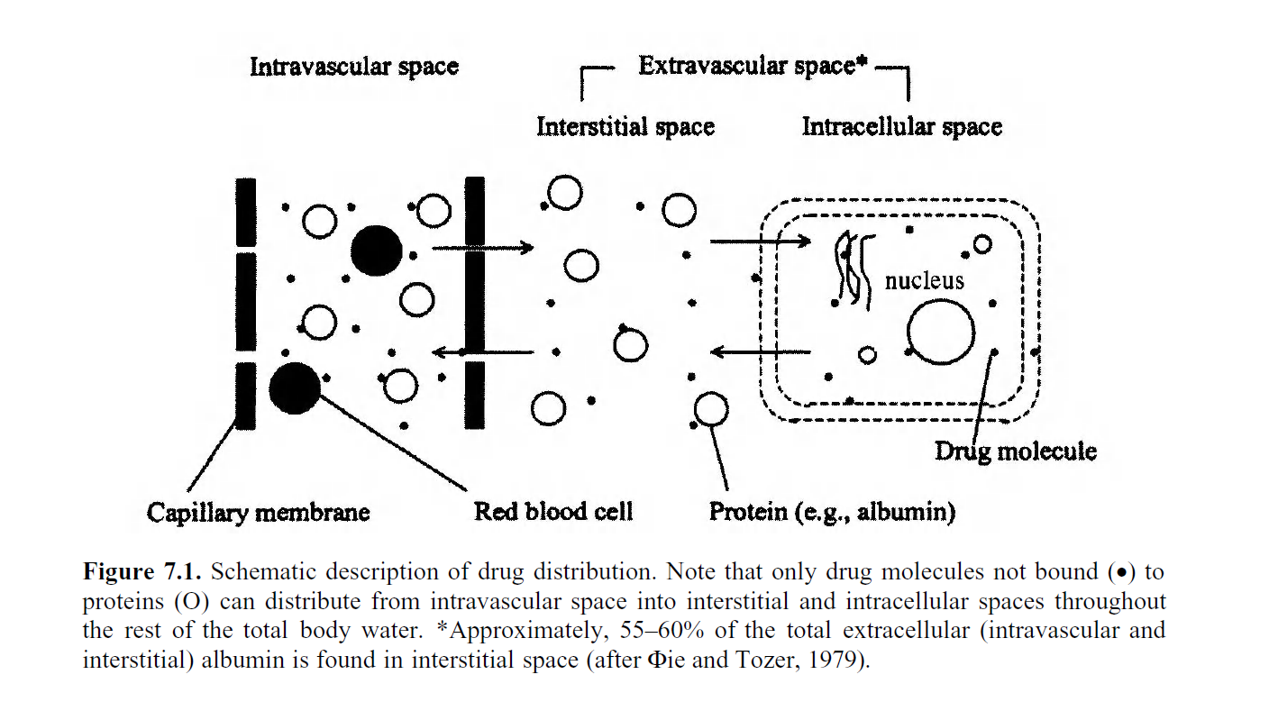

Slide 70
DRUG DISTRIBUTION
1. Vascularity / Regional blood flow
Drug in bloodstream is distributed to body:
# Central compartment
-(major organs & blood vessels)
low lipid solubility (hydrophilic)
low volume of distribution (low Vd)
# Peripheral compartment
(skin & fat stores)
high lipid solubility (lipophilic)
high volume of distribution (high Vd)

Slide 71
Drug Distribution ; Regional blood flow
Blood flow - important for the rate of drug uptake
well-perfused tissues (heart, brain, kidney, splanchnic organs) will achieve high tissue concentration sooner than poorly perfused tissues (adipose, bones)
The heart, Liver, kidney and the brain receive most drugs after absorption ▬ more perfused.
Drug delivery to and from the muscle, skin and adipose tissue is slower ▬ Less perfused

Slide 72
Drug Distribution: Binding
2. Binding –in the blood or tissue compartment will tend to increase the drug’s conc. in that compartment.
Only a free (unbound drug) can be distributed
1. Protein binding
Two factors determine degree of plasma protein binding:
1. Affinity of drug for plasma protein
2. # of binding sites available
Weak acid drugs bind to albumin (phenytoin, salicylates, and disopyramide are extensively bound)
Weak basic drugs bind to serum globulins → α₁ acid glycoprotein (quinidine, lidocaine, propranolol)

Slide 73
Drug Distribution
Protein binding
Limits the drug conc in tissues because bound drug cannot enter tissues, as a result, leads to high concs of drug in the plasma (bound + free drug)
Bound drug is NOT therapeutically active
There is an equilibrium between the free drug and the bound drug
Drug is gradually released from the protein (acts as storage for drug) as the free drug is utilized and removed

Slide 74
Drug Distribution
Protein binding
Is non-selective
The # of binding sites on plasma protein is limited
Drugs will compete with other drugs, hormones, or other endogenous substances for protein binding sites
Ex: Glyburide (sulfonamide) can be displaced by warfarin, phenytoin, salicylates, etc.. and cause ↑ hypoglycaemic effects (more free drug in body)
Ex: Warfarin can be displaced by indomethacin, aspirin, etc.. which can ↑ bleeding.
These interactions may necessitate a dosage adjustment or discontinuation of the other drug
Notes:
The drug with the higher affinity constant will successfully displace the drug with
the lower. The result is an increase in the free drug concentration of the latter. For
example, tolbutamide (an oral hypoglycemic agent used in maturity-onset diabetes
mellitus) is approximately 95 percent bound and 5 percent free

Slide 75
Plasma- Protein Binding
Free form
Pharmacologically active
Bound form
Pharmacologically inactive
Receptor Site
Protein-bound drug
Free Drug

Slide 76
Distribution: BINDING TO PLASMA PROTEINS
Quite a number of drugs bind to circulating plasma proteins. mainly albumin but globulins, lipoproteins and acid glycoprotein's can also bind to drugs.
The acidic drugs bind mainly to plasma albumin whilst the basic drugs bind to ∝₁-acid glycoprotein(a globulin).
The amount of drug that binds the plasma proteins depends on:
The free drug concentration.
Affinity of the drug for the binding sites.
The protein concentration in the body- Conditions that affect protein levels affect drug-protein binding and distribution (Burns, CKD, Liver disease, malnutrition)

Slide 77
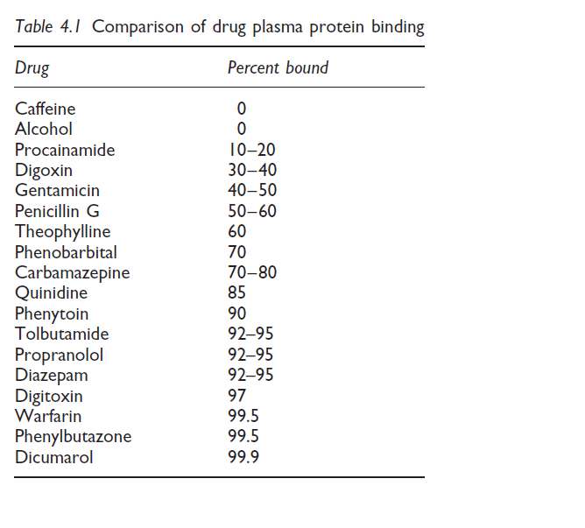
Notes:
The drug fraction bound to plasma protein cannot diffuse, cannot be metabolized, and cannot be excreted because the molecular weight of the drug–protein complex exceeds 65,000 daltons. The bound fraction represents, therefore, a storage form that is released when the concentration of free drug decreases. The normal therapeutic
dose of a drug is determined taking this into account.

Slide 78
Protein binding & drug distribution
Usually it is the unbound or the free drug that distributes into the tissues of the body, ▬ responsible for the clinical effect or toxicity of drug.
NB:
Only the unbound drug can
bind to receptors to elicit Pharmacological response
cross tissue membranes, gain access to cellular enzymes,
be metabolized and excreted from the body
Increased plasma concentration of free drug may be clinically relevant if the drug is highly protein bound
OR
not clinically relevant if the change in plasma concentration is a transient increase.
Notes:
Whether or not a drug interaction of this type is clinically significant depends on
the distribution and elimination properties of the drug affected. Competition between
two drugs for the same plasma protein binding site is fairly common. However, it is
only clinically relevant if the drugs have high protein binding, a low therapeutic
index and a relatively small volume of distribution.

Slide 79
Plasma binding of drugs
1000 molecules
99.9%
high % bound lower
90.0%
1
molecules free
100
Fewer free molecules means :
less drug in active form - therefore action smaller
lower concentration gradient of diffusable drug - slower onset
less at biotransformation & excretion sites - longer action
CHANGE in drug binding = possible serious interaction (eg.100-fold increase in free pharmacologically active drug)
Effective TOXIC
79
GEN. INTRO. PHARMACOLOGY

Slide 80
3. Lipid solubility :Membrane permeability
Lipid solubility: in organs with a high lipid content, a high concentration of lipid-soluble agents is reached:
a very lipid soluble anaesthetic agent will transfer out of the blood more rapidly and to a greater extent than a drug with a low lipid solubility.
Generally, high lipid solubility>>> tissue accumulation >>longer duration >>> slow clearance
Water-soluble drugs tend to stay within the blood and interstitial space.
Membrane permeability
For a drug to enter an organ (tissue), it must permeate all membranes that separate the organ from the site of drug administration

Slide 81
3. Molecular Size
Smaller molecules will diffuse more readily than larger ones.
Graham’s law applies
4. Degree of Ionization
Unionized forms favor membrane penetration and greater tissue distribution.
Depending on the pH of a compartment, unionized forms may become ionized after crossing the membrane preventing their diffusion backwards – ‘ion trapping’.
Eg: Fetal pH is also usually less than maternal pH, which can lead to ion trapping and greater drug concentrations in the fetus

Slide 82
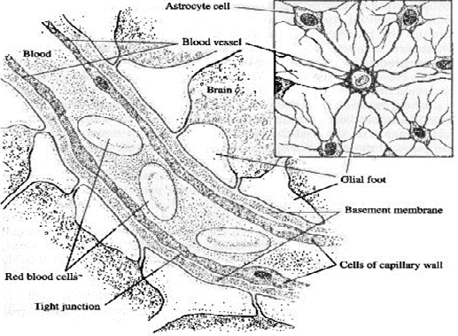
Drug Distribution- Lipid Barriers
The unique design of some membranes may influence the distribution of drugs into some compartments in the body
A. Blood-brain barrier (BBB) – lipid membrane located between plasma and the extracellular space in the brain
Blood and brain are separated by capillary cells packed tightly together and by a fatty barrier called a glial sheath, which is made up of extensions (glial feet) from nearby astrocyte cells. A drug moving from blood to brain must diffuse across the cells of the capillaries and because there are tight jxns rather than pores b/n the cells, the drug must then move through the fatty glial sheath
Protective barrier from xenobiotics but may also hamper tmt. to the CNS

Slide 83
Drug Distribution: Blood-brain barrier (BBB)
The entry of drugs is restricted into the CNS and CSF (cerebrospinal fluid)- Selective permeability
Lipid solubility and cerebral blood flow limit permeation of the CNS
Highly lipophilic drugs can pass the BBB (i.e. benzodiazepines), Low MW and unbound drugs
Intrathecal route bypasses BBB to access the CSF
Not all drugs enter the brain or CNS, however, the difficulty of passage into the brain can also serve as a protective barrier when treating other parts of the body
Excludes ionized substances; Active transport mechanisms;
Not uniform – leaky (circumventricular areas)
Notes:
Other drugs may enter via active transport and facilitated diffusion, Efflux pumps

Slide 84
Drug Distribution
B. Blood-placenta barrier – the foetus is exposed to most drugs the mother ingests at anytime during the pregnancy.
Lipid soluble drugs may cross the placenta and cause developmental toxicity.
Nicotine withdrawal symptoms in neonates,
Fetal Alcohol Syndrome (FAS) for alcoholic mothers.
The pH of fetal blood is lower than that maternal blood; weakly basic drugs may be trapped (e.g. local anaesthetics).

Slide 85
Drug Distribution
C. Mammary transfer of drugs
Lipid soluble drugs in maternal plasma easily diffuse across capillary walls, alveolar cell walls of milk buds into milk.
Non-electrolyte drugs (do not depend on pH gradient – i.e. alcohol) readily reaches the same concentration as in the plasma, independent of the pH of breast milk
Basic drugs are trapped in slightly acidic breast milk (6.35–7.35) Eg. Lithium, iodine.
Large drugs like heparin (30,000Da )and insulin (6000Da) are practically excluded
Others: Blood – aqueous humor barrier, blood – testis barrier
Notes:
Drugs < 600-800 Da transferred easily eg. Alcohol, nicotine, caffeine

Slide 86
Drug Distribution
5. Storage Depots (Tissue/Depot binding)
Drugs may collect in certain body tissues
These tissues are called “depot sites” or “silent receptors” (fat, muscle, organs, bones, etc)
Depot binding reduces bioavailability, slows elimination, can increase drug detection window. Affects PK and PD
Depot-bound drugs can be released during sudden weight loss – may account for flashback experiences?
Redistribution – after a drug has accumulated in tissue, i.e. thiopental in fatty tissues, drug is gradually returned to the plasma

Slide 87
5. Storage Depots
A. Fat – lipophilic drugs accumulate here and are released slowly (due to low blood flow)
Ex: thiopental (or other anesthetic) – causes ↑ sedation in obese patients
B. Bone – Ca⁺⁺ binding drugs accumulate here
Ex: tetracycline can deposit in bone and teeth → will cause mottling or discoloration of teeth
C. Liver – many drugs accumulate in the liver due to an affinity for hepatic cells
Ex: quinacrine (antimalarial agent) – has higher conc (22,000 times) in the liver than in plasma due to long term administration
D. Skin – some drugs accumulate here
Ex: griseofulvin (antifungal of skin, hair, and nails) binds to keratin protecting the skin from new infection
Chloroquine, highly tissue bound and stays in the body for a longer time.

Slide 88
VOLUME OF DISTRIBUTION V_{d}
Body water available for drugs to distribute into is in four compartments as follows: (expressed as percentages of body weight)
Intracellular fluid (within cytoplasm) – 40%
Plasma (intravascular) – 5%
interstitial fluid (btn. blood vessels and cells) – 15%
transcellular fluid 1% cerebrospinal, intraocular, pleural and synovial fluids etc.
NB: Females generally have less body fluids for drug distribution.

Slide 89
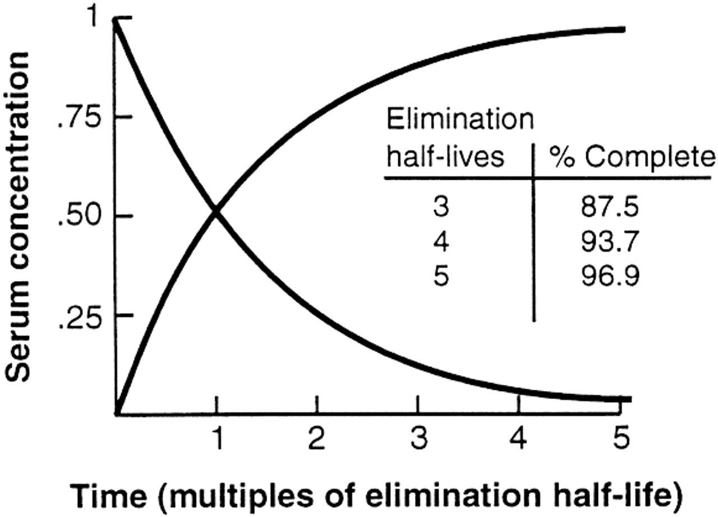
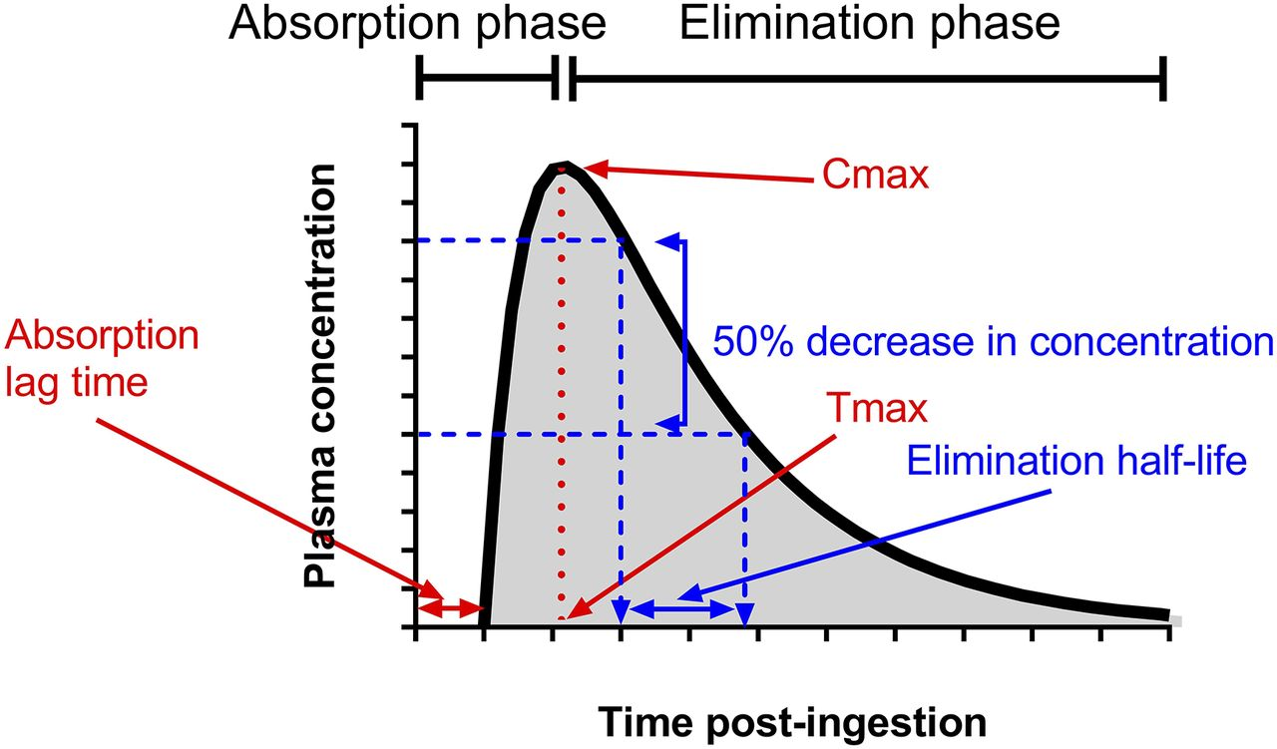
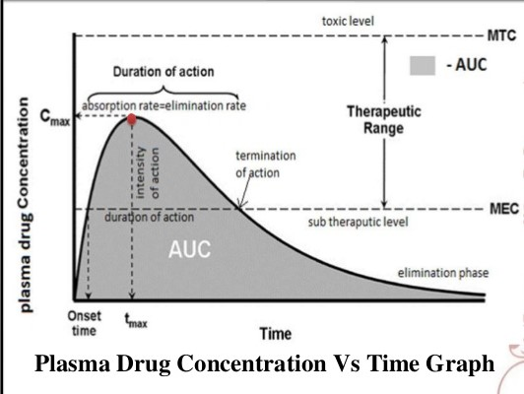
Notes:
C_{max} - Maximum conc. achieved in the blood
T_{max} - Time taken to attain maximum conc.

Slide 90
DRUG METABOLISM
ADME

Slide 91
LEARNING OBJECTIVES
By the end of this lecture, the student should be able to
Describe the different types of metabolic transformations that drugs undergo and their physiological consequences.
Describe the potential changes in chemical properties of a drug metabolite versus the properties of the parent drug.
Discuss the concept that the effects of one drug can be modified by the prior, or simultaneous, administration of a second drug.
Discuss the role that drug metabolism plays in mediating drug-drug interactions.
Summarize the major mechanisms that can lead to drug-drug interactions at the level of drug metabolisms.
Discuss the role that enzyme induction and inhibition of metabolic enzymes play in drug metabolism.

Slide 92
DRUG METABOLISM
The biologic transformation of a drug molecule by enzymes present in the body is commonly referred to as drug metabolism.
The process of drug metabolism is usually considered to be a process that leads to detoxification and increased water solubility.
However,
metabolism as a chemical transforming process can lead to an increase in toxicity, an activation or deactivation of the biologic action, and in some cases a decrease in water solubility.
Notes:
Drug metabolism is an important aspect of pharmacology and medicine.
The rate of drug metabolism determines duration and intensity of a drug’s pharmacological action
Drug metabolism affects multidrug resistance in infectious disease and in chemotherapy of cancer
Action of some drugs as substrates or inhibitors of enzymes involved in xenobiotic metabolism are a common reason for hazardous drug interactions.

Slide 93
DRUG METABOLISM
Drugs represent only one small group of substrates that may undergo metabolism.
Any substance foreign to the body can potentially be metabolized after entering the body.
A more general term for exogenous substances is the term xenobiotics (from Greek xenos “stranger” and biotic “related to living things).

Slide 94
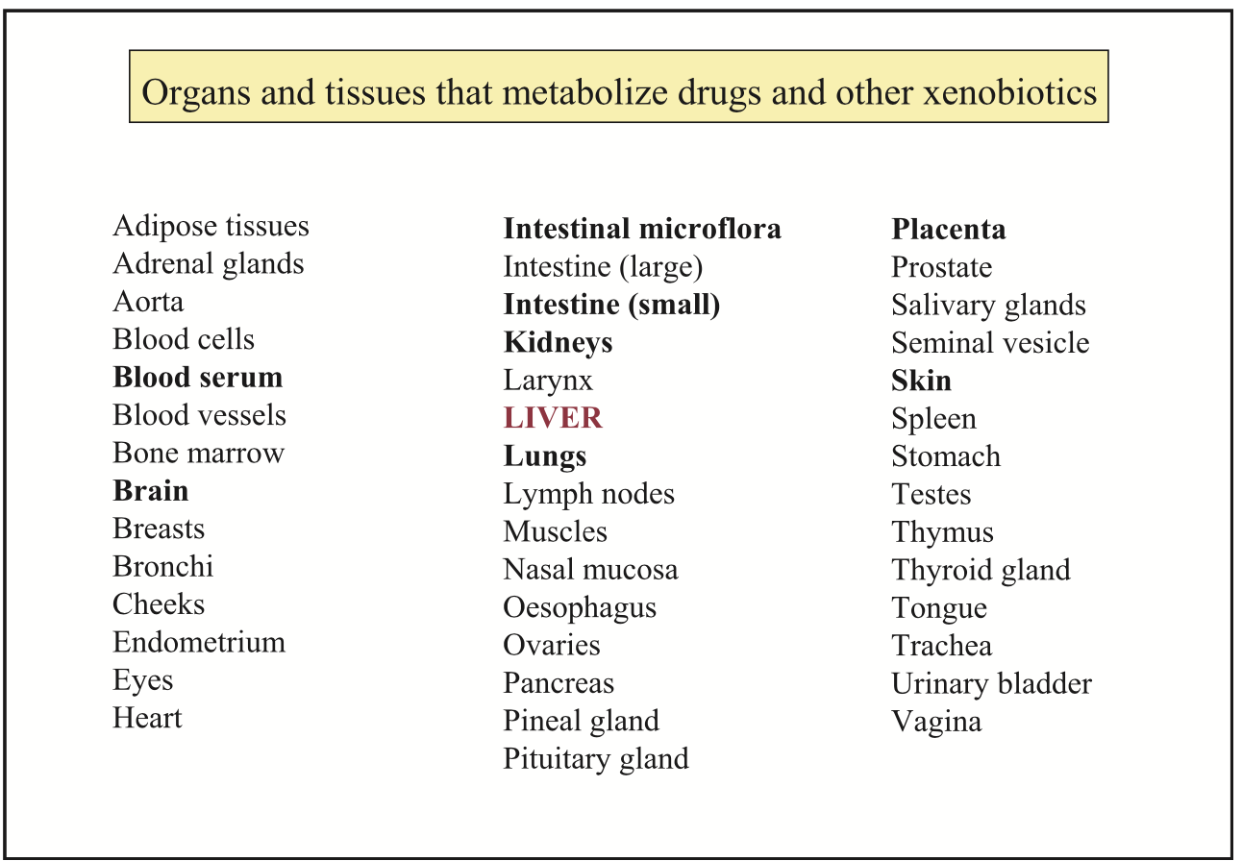
Notes:
The liver has been called the chemical factory of the body, and indeed it is an organ whose function is to breakdown and synthetize compounds, xenobiotics included. Most drug-metabolizing enzymes are expressed in the liver, and at comparatively high levels. When introducing drug-metabolizing organs of secondary or tertiary importance, it becomes important to consider these two criteria namely a) the variety of enzymes expressed, and b) the levels of expression. To visualize the two criteria, one can just think of a histogram with each enzyme being a bin. In the liver, most bins are occupied, and at relatively high levels. The organs and tissues of secondary importance (bold in the Figure)either express most xenobiotic-metabolizing enzymes at comparatively lower levels (e.g., the brain), or express a limited number of enzymes at relatively high levels (e.g., blood and the kidneys). Tissues and organs of tertiaryimportanceexpressloworverylowlevelsofxenobiotic-metabolizingenzymes. However, their significance should not be underestimated, since they may be involved in the bioactivation or toxification of a few specific substrates. Taken globally, the list in this Figure includes almost all organs, a notable exception being the ossified organs (bones and teeth) whose xenobiotic-metabolizing activity appears all but impossible to investigate.

Slide 95
DRUG METABOLISM
Xenobiotics represent any foreign chemicals such as food additives (i.e., herbicides and pesticides), volatile chemicals (i.e., substances in cigarette smoke), chemicals in the drinking water, environmental pollutants as well as drugs.
Xenobiotic metabolism, while primarily occurring in the liver,
may also occur at extrahepatic sites, including intestine (both within the lumen and the intestinal mucosa), kidney, lungs, nervous tissue, and plasma.
Notes:
Xenobiotic metabolism is a set of metabolic pathways that modify chemical structure of xenobiotics (Cpds foreign to an organism’s normal biochemistry, such as drug or poison)

Slide 96
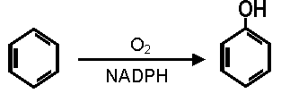
DRUG METABOLISM
Transformation of Xenobiotics by Biological Systems

Slide 97
IMPLICATIONS OF DRUG METABOLISM
Termination of Drug Action:
Atropine tropic acid & tropine
Activation of Prodrug:
L dopa dopamine
Bioactivation And Biotoxication:
Terfenadine fexofenadine
Acetaminophen Reactive Metabolite N-Acetylbenzoquinoneimine (NAPQI)

Slide 98
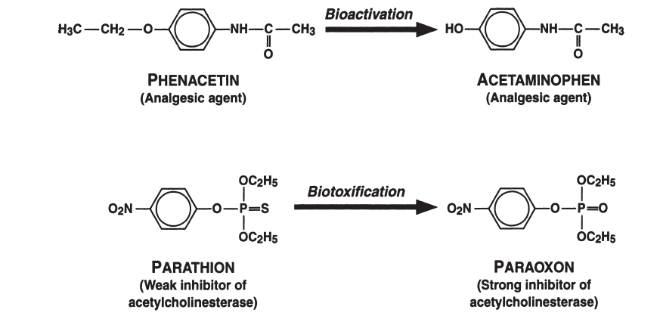
Comparison of metabolic bioactivation and biotoxification processes

Slide 99
IMPLICATIONS OF DRUG METABOLISM
Carcinogenesis: Metabolites of these agents interact with DNA
3,4 Benzopyrene
Aflatoxin
N-Acetylaminofluorene
Teratogenesis
THALIDOMIDE: Fetal malformations in humans, monkeys, and rats occur due to metabolism of the parent compound to a teratogen. This occurs very early in gestation

Slide 100
DRUG METABOLISM
The first step in the elimination of lipid soluble drugs is metabolism to more polar compounds that are water soluble and excreted by the kidneys.
Drugs that are water soluble may be excreted unchanged by the kidney.
Lipid soluble drugs are not easily excreted by the kidneys because they are largely reabsorbed from the proximal tubules after glomerular filtration.
such drugs have to undergo biotransformation before they can be excreted by the kidneys.

Slide 101
DRUG METABOLISM
Biotransformation / Drug metabolism occurs mainly in the liver and is generally divided into two types of reactions, referred to as
Phase 1 reactions (functionalization rxns)
reactions include oxidation, reduction, and hydrolysis reactions. These reactions generally involve introduction of a new functional group into the molecule.
Phase 2 reactions (transferase rxns)
Usually follows phase 1, involve conjugation reactions such as acetylation, sulfation, glucuronidation, and conjugation with amino acids.

Slide 102
General Pathways of Drug Metabolism
Phase I reaction – (oxidation, reduction, hydrolysis)
Generally, the parent drug is oxidized or reduced to a more polar metabolite by introducing or unmasking a functional group (-OH, -NH₂, -SH)
Products of Phase I reactions may be either pharmacologically active or inactive
The more polar the drug, the more likely excretion will occur
This reaction takes place in the smooth (no ribosomes) endoplasmic reticulum in liver cells (hepatocytes)

Slide 103
Phase I reaction
The smooth microsomes are relatively rich in enzymes responsible for oxidative drug metabolism
Important class of enzymes – mixed function oxidases (MFOs)
The activity of these enzymes requires a reducing agent, NADPH and molecular oxygen (O₂)

Slide 104
PHASE I METABOLISM
Two microsomal enzymes play a key role:
NADPH-cytochrome P450 reductase, a flavoprotein
Cytochrome P450, a hemoprotein, the terminal oxidase
Generally, reduction and hydrolysis reactions play subordinate roles in xenobiotic metabolism compared to oxidation reactions.

Slide 105
PHASE I METABOLISM
Cytochromes P450 named for their absorption of light at 450 nm when complexed with carbon monoxide
are a superfamily of heme-containing enzymes found throughout the animal and plant kingdoms and in yeast and bacteria.
Cyp3A4 alone is responsible for more than 60% of the clinically prescribed drugs metabolized by the liver

Slide 106
DRUG METABOLISM: PHASE I REACTIONS
The liver metabolic reactions are mostly catalyzed by the mixed function oxidases or the cytochrome P450 enzymes.
Important exceptions to this rule are ethyl alcohol and caffeine, which are oxidatively metabolized by enzymes primarily present in the soluble, cytosolic fraction of the liver.
( There are multiple iso-forms of the P450 enzymes which can act on numerous substrates)
Different members of the iso-zymes have distinct but often overlapping substrate specificities.

Slide 107
Some act on the same substrates as the other but at different rates.
The mammalian P450s involved in the oxidation of foreign compounds are designated CYP1, CYP2, CYP3, and CYP4.
More than 20 different human CYP isoforms have been characterized.

Slide 108
P₄₅₀ iso-zyme | Drug(s) or substrate(s)
Cyp 1A1 | Theophylline
Cyp 1A2 Cyp 3A4 | Caffeine, P’mol, Theophylline, ondansetron Erythromycin, midazolam, nifedipine,
Cyp2C9 | Warfarin, Tolbutamide, Ibuprofen, Phenytoin
Cyp2D6 Cyp 2E1 | Debrisoquine, Codeine Metoprolol, nortryptyline Alcohol, Halothane

Slide 109
Hydrolysis reactions
Esterases catalyze hydrolytic conversions of any many drugs. Examples include:
Cleavage of suxamethonium by plasma cholinesterase.
Hydrolysis of aspirin (acetylsalicylic acid) to salicylate
Hydrolysis of enalapril to enalaprilat

Slide 110
DRUG METABOLISM: PHASE 1 REACTIONS
TERM | DEFINITION
Phase I Rxns | that convert the parent drug to a more polar (water-soluble), or a more reactive product by unmasking or inserting polar functional group as OH, SH,NH₂ more polar, less active: deamination: diazepam -- nordiazepam hydroxylation: phenytoin activated: O-dealkylation: codeine--morphine
The phase 1 metabolites are usually more reactive and sometimes more toxic than the parent compound.

Slide 111
PHASE II METABOLISM
The Phase II metabolism also known as transferase reactions. A molecule endogenous to the body donates a portion of itself to the foreign molecule/drug.
This almost always lead to abolition of p/cological activity or produces a p/cologically inactive compound that is more water soluble and readily excreted in the urine mainly, or by the bile.
The liver is the major site for phase II conjugation reactions but conjugation can also occur in the gut.
D + ENDOX DX + ENDO

Slide 112
PHASE II METABOLISM
Phase II reaction
involves coupling the drug or it’s polar metabolite with an endogenous substrate (glucuronic acid, sulfate, acetate or amino acids(glycine, glutamine).
The endogenous substrates originate in the diet, so nutrition plays a critical role in the regulation of drug conjugation
Drugs undergoing phase II conjugation reactions (glucuronidation, acetylation, methylation, and glutathione, glycine, and sulfate conjugation) may have already undergone phase I transformation
Some parent drugs may already possess a functional group that may form a conjugate directly

Slide 113
PHASE II METABOLISM
Phase II Rxns | that increase water solubility by conjugation of the drug molecule with a polar moiety: glucuronidation: morphine sulfate conjugation: acetaminophen acetylation: sulphonamides
all tend to be less lipid soluble and therefore better excreted (less well reabsorbed)

Slide 114
Amino Acid Conjugation
Amino acid reactions involves glycine and glutamine. Glycine forms conjugates with nicotinic acid and salicylate.
Glutamine forms conjugates with 4-aminosalicylates.
Hepatocellular damage depletes intracellular pool of these amino acids hence restricting this pathway.
Amino acid conjugation is reduced in neonates.
Acetylation
Acetate derived from acetyl coenzyme A conjugates with drugs such as isoniazid, hydralazine and procainamide

Slide 115
Glucuronidation
Conjugation reactions between glucuronic acid and carboxyl groups are involved in metabolism of bilirubin, salicylates and lorazepam.
Some patients inherit a deficiency of glucuronide formation that presents clinically as non-hemolytic jaundice due to excess unconjugated bilirubin (Crigler-Najjar syndrome).
Drugs that are normally conjugated via this pathway aggravate jaundice in such patients.
O-glucuronides formed by reaction with hydroxyl group result in a ether glucuronide
This occurs with drugs such as acetaminophen and morphine.
Notes:
UDP-glucuronosyltransferases

Slide 116
Sulfation
Cytosolic sulfonyltransferase enzymes (SULTs) catalyze sulfation of hydroxyl and amine groups by transferring a sulfonyl group from 3’-phosphoadenosine 5’-phosphosulfate (PAPS) to a xenobiotic.
Drugs can form conjugates with other Phase II endogenous molecules such as
Glutathione (Tripeptide – Cys-Glu-Gly)
Methylation (Methyl groups donated by S-adenosyl methione catalyzed by Catechol O-methyltransferase (COMT) - a methylating enzyme.
Norepinephrine, dopamine and epinephrine inactivation.

Slide 117
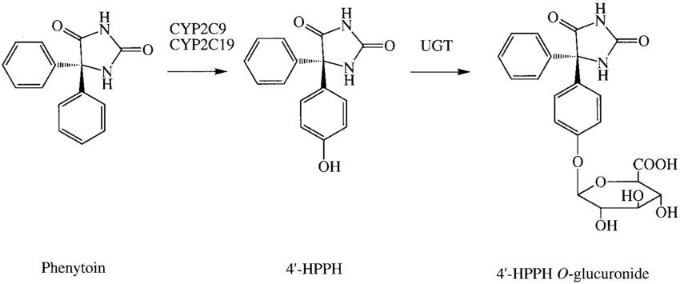
Phase II reaction
For example, Phenytoin is initially oxidized to 4-hydroxyphenytoin then glucuronidated to 4-hydroxyphenytoin-glucuronide readily excreted via the kidney.

Slide 118
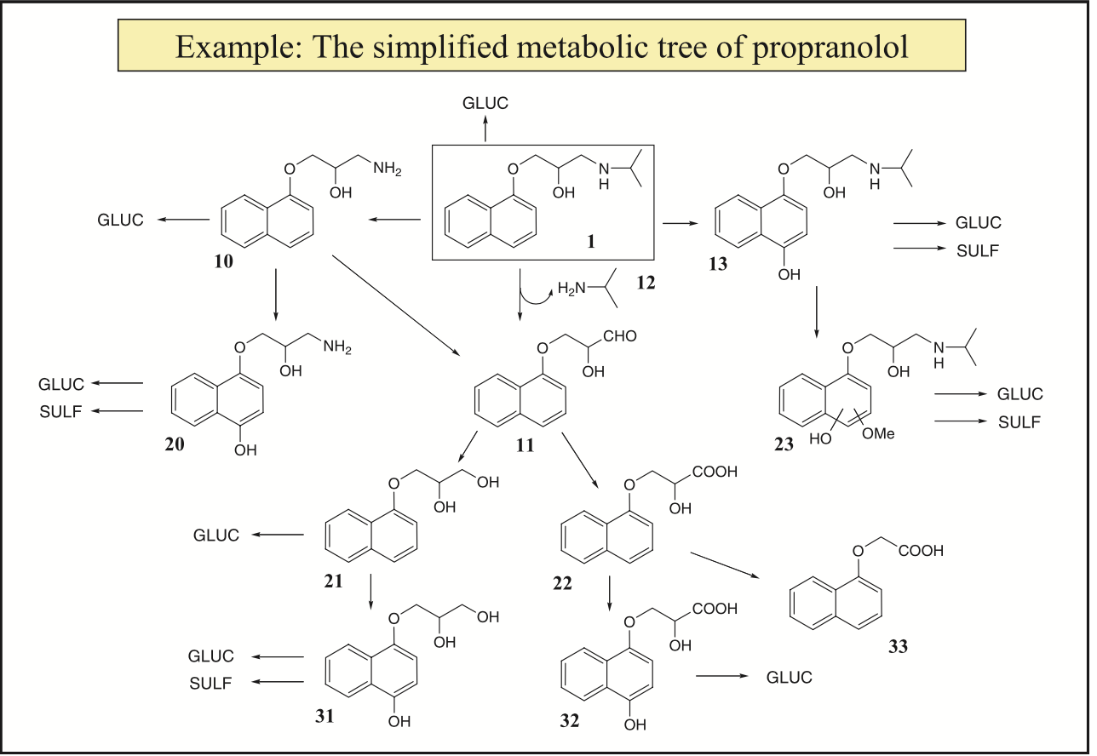
Notes:
Propranolol(1),the first beta-blocking drug, is extensively metabolized in humans (>90% of an oral dose) [45]. Its major human metabolites are presented here to illustrate the concept and potential complexity of a metabolic tree. The primary metabolites of propranolol (1) are its O-glucuronide, the primary amine 10 resulting from oxidative O-dealkylation, the aldehyde 11 formed by a reaction of oxidative deamination which also liberates isopropylamine (12), and the phenol 4-hydroxypro- pranolol (13); minor positional isomers of 13 have also been characterized in humans. Note that the aldehyde 11 is also a secondary metabolite formed from the primary amine 10. All the oxidative reactions so far are catalyzed by cytochromes P450 (CYPs, see Part 2). Secondary metabolites are the primary alcohol 21 and the carboxylic acid 22 formed from the aldehyde 11 by alcohol dehydrogenases and aldehyde dehydrogenases, respectively (see Part 2). Other secondary metabolites are the phenol 20 and isomeric phenols 23. Tertiary metabolites include the two phenols 31 and 32, and the minor a-naphthoxy acetic acid metabolite formed by oxidative chain-shortening. Many of these metabolites are also excreted as the O-glucuronide and the O-sulfate

Slide 119
Biotransformation in the elderly
Hepatic enzymes and other organs deteriorate over time
Biotransformation in the foetus or neonate
These individuals are very vulnerable to the toxic effects of drugs
Their liver and metabolizing enzymes are under-developed
They also have poorly developed blood brain barrier
Can get hyperbilirubinemia which leads to encephalopathy
Have poorly developed kidneys which can alter excretion and cause jaundice

Slide 120
Variations in drug metabolism:
Generally, men metabolize faster than women (ex: alcohol)
Diseases can affect drug metabolism (ex: hepatitis, cardiac (↓ blood flow to the liver), pulmonary disease)
Genetic polymorphism.
Differences in the metabolism of drugs in different races or populations. E.g 50% of Caucasians are slow acetylators of Isoniazid, Hydralazine and procainamide.
Some individuals are poor metabolizers or extensive metabolizers of debrisoquine, (i.e. hydroxylation of debrisoquine via CYP 2D6)
Other drugs metabolized by 2D6 are metoprolol and nortriptyline.

Slide 121
Presystemic metabolism and first-pass effect
Following oral administration drugs gain access to the systemic circulation via the portal vein, so the entire absorbed dose is exposed first to the intestinal wall and then to the liver before gaining the access to the rest of the body.
If the drug is rapidly metabolized, a substantional fraction will be extracted and metabolized before it reaches the systemic circulation. This it known as presystemic metabolism.
Presystemic metabolism in the liver: in the gut:
lidocaine,morphine levodopa, salbutamol

Slide 122
Presystemic metabolism and first-pass effect
Pronounced first-pass metabolism necessitates high oral doses by comparison with the IV route.
Alternative routes of drug delivery e.g.
rectal,
buccal,
sublingual,
inhalation or
transdermal
partly or completely bypass presystemic metabolism (elimination).

Slide 123
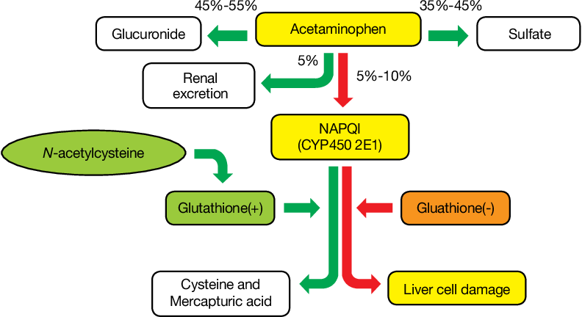
Paracetamol Toxicity
Notes:
Chronic alcohol intake induces CYP2E1, enhances the toxication route (increased NAPQI) and eventually causes liver damage.
Regular intake of paracetamol during fasting or chronic ethanol intake should be avoided
N-acetylcysteine (precursor for glutathione) is the antidote for acetaminophen poisoning. It reacts with the electrophile (NAPQI)

Slide 124
DRUG EXCRETION
ADME

Slide 125
DRUG ELIMINATION
Irreversible loss of drug from the body.
It occurs by two processes: Metabolism and Excretion
Clearance is the sum of all drug eliminating processes.
Renal drug excretion:
Drugs differ greatly in the way they are cleared by the kidneys.
For e.g. penicillins are almost completely cleared on a single transit through the kidney where as diazepam is cleared extremely slowly by the kidneys.
Urine is the principal but NOT the only route of excretion
M i n o r r o u t es :
drugs may be excreted in
saliva (phenytoin),
sweat (salicylates),
expired air (narcotics),
breast milk (amiodarone, aspirin).
Notes:
In order for a drug or its metabolite(s) to be completely eliminated from the body it must undergo excretion as well as metabolism.
The renal processes operating to modify the blood level of a drug include
glomerular filtration; (2) tubular secretion; and (3) tubular reabsorption.

Slide 126
DRUG EXCRETION
some drugs are mainly excreted by the kidney without prior metabolism -digoxin, gentamicin, lithium
most drug metabolites are inactive and their rate of renal excretion is usually without clinical importance- neuroleptics
if metabolites retain pharmacological activity, drug action may be terminated by excretion NOT by biotransformation- nordiazepam
Notes:
For most drugs
reabsorption is a passive process that is influenced by the lipid solubility of the drug,
the pKa of the drug, and the pH of the urine. Lipophilic drugs, which are well
absorbed in the GI tract, are also generally reabsorbed across the tubule epithelium.
Conversely, hydrophilic drugs, which are poorly absorbed orally, are also reabsorbed
poorly and are therefore more readily excreted in the urine. If urine flow increases, the time that a drug is exposed to the reabsorptive surface
of the kidney is decreased. This principle forms the basis for the treatment of certain
extreme cases of acute drug overdose. In these situations patients undergo forced
diuresis with large volumes of fluid in order to accelerate drug clearance (e.g.,
meprobamate poisoning). The effect of urinary pH on drug ionization also has toxicological implications.
For example, in cases of phenobarbital (a weak acid barbiturate) overdose the urine
can be alkalinized (the pH elevated) by administering sodium bicarbonate to the
patient. The resultant increase in pH shifts the dissociation equilibrium for this weak
acid to the right, producing an increase in the proportion of the ionized form, less
reabsorption in the kidneys, and more rapid elimination. Conversely, acidifying the
urine with ammonium chloride will increase the excretion rate of drugs that are weak
bases since they will be more protonated (ionized) and less reabsorbed (more polar,
less lipophilic).

Slide 127
EXTRARENAL CLEARANCE OF DRUGS
Excretion represents the final common pathway for the elimination of drugs. The kidneys are the most significant of the excretory sites.
Extrarenal sites include biliary, pulmonary, sweat, salivary, and mammary glands.
The lungs are the primary site of elimination for gaseous anesthetics and any other compounds that are volatile.
For example, certain aromatic hydrocarbons are largely eliminated in the expired air.
The major pathway for the elimination of ethanol, of course, is metabolism by the liver. However, approximately 2% is eliminated via the lungs.
Notes:
A number of drugs are eliminated partially by transport into milk during lactation.
For most drugs, their concentration in milk is similar to that in the mother’s circulation.
The usual maternal dose transferred to the infant is in the range of 0.05 to 2
percent. In some cases, a significant pharmacological effect can be produced in babies
who are breast-feeding. Among the drugs that are specifically contraindicated during
breast-feeding are cocaine, lithium, and methotrexate. In addition, a number of drugs
should be used with caution, including aspirin and phenobarbital.

Slide 128
Biliary excretion
In addition to metabolism, the liver contributes to clearance by secreting approximately 0.5–1.0 liters of bile daily Important constituents of bile include conjugated bile salts, cholesterol, phospholipid, bilirubin diglucuronide, electrolytes, and drugs.
Biliary excretion is primarily important for compounds with a molecular weight greater than 500 while compounds with a molecular weight less than 300 are preferentially excreted into the urine.
Bile is initially concentrated in the gall bladder and subsequently transported to the small intestine (duodenum) via the bile ducts. Drugs entering the duodenum may be eliminated in the feces or recycled back into the general circulation (i.e., enterohepatic circulation).
Notes:
Biliary excretion is truly a route of elimination only to the extent that the excreted drug fails to be reabsorbed. A mechanism facilitating the reabsorption of certain drugs is the hydrolysis of glucuronide conjugates via β-glucuronidase present in intestinal flora.

Slide 129
Drug Clearance (Elimination)
Clearance is the sum of all drug eliminating processes.
Principally determined by hepatic metabolism and renal excretion.
Renal Clearance
Defined as the volume of plasma containing the amount of drug that is removed by the kidney in a given period of time.
C_{u}=urinary concentration, C_{p}=Plasma conc.
V_{u}= Rate of flow of urine.

Slide 130
Half life (T_{1/2})
The plasma-half life of a drug is the time required for the plasma concentration of the drug to fall to ½ (half) of its original value.
Whole body half-life: Time it takes to eliminate half of the body content of a drug.
4 half-lives must elapse after starting a drug dosing regimen before full effects will be seen
k = The elimination rate constant
The plasma t_{1/2} is directly proportional to the volume of distribution and inversely proportional to the rate of clearance.
It can be used to determine dosage interval to achieve a target concentration-time profile.

Slide 131
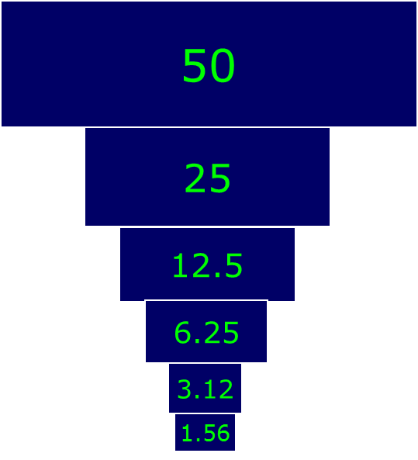
DRUG HALF-LIFE (t_{1/2} )
1 t1/2 - 50 % drug is eliminated
2 t1/2 - 50+25 (75 %) drug is eliminated
3 t1/2 - 50+25 +12.5 (87.5 %) drug is eliminated
4 t1/2 - 50+25 +12.5+6.25 (93.7 %) drug is eliminated
Thus, nearly complete drug elimination occurs in 4-5 half lives.

Slide 132
Elimination: kinetics
First-order elimination - implies that the rate of elimination is proportionate to the concentration, i.e., the higher the concentration, the greater the amount of drug eliminated per unit time.
A constant fraction of drug is eliminated per unit of time.
When drug concentration is high, rate of disappearance
is high.

Slide 133
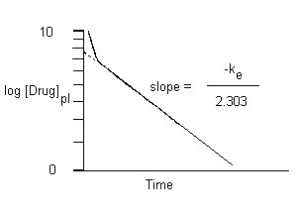
Elimination: kinetics
Zero-order elimination (saturation kinetics). Z-o elim. implies elimination at a constant rate regardless of concentration. As a result, the drug´s concentration in plasma decreases in a linear fashion over time.
Constant amount eliminated per unit of time.
This is typical of ethanol, and of phenytoin and aspirin at high therapeutic or toxic concentration.

Slide 134
Comparison
First Order Elimination
[drug] decreases exponentially w/ time
Rate of elimination is proportional to [drug]
Plot of log [drug] or ln[drug] vs. time are linear
t _{1/2} is constant regardless of [drug]
Zero Order Elimination
[drug] decreases linearly with time
Rate of elimination is constant
Rate of elimination is independent of [drug]
No true t _{1/2}

Slide 135
THANK YOU

